Slide 1

Toolkit Doc13 Caster
May 4, 2010

Slide 2
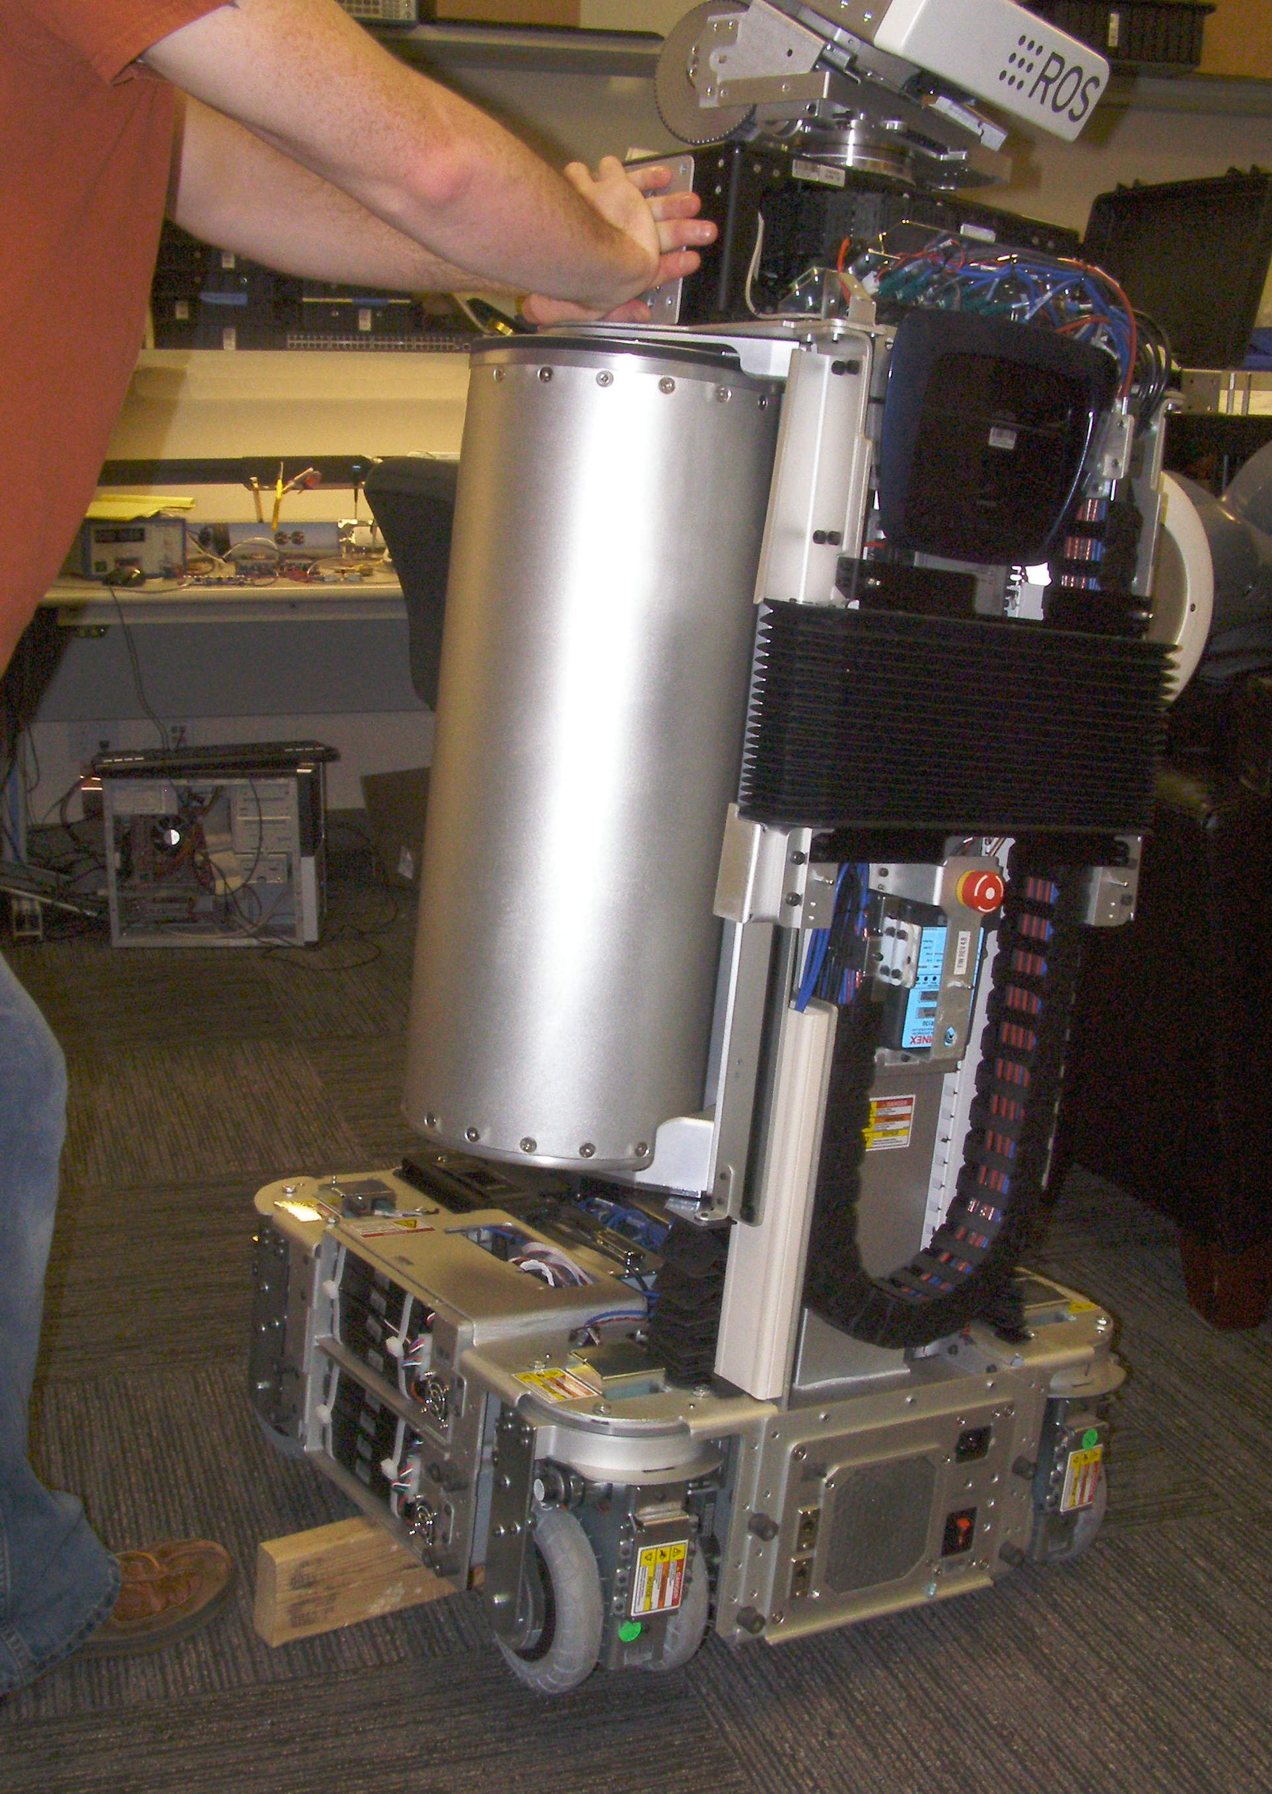
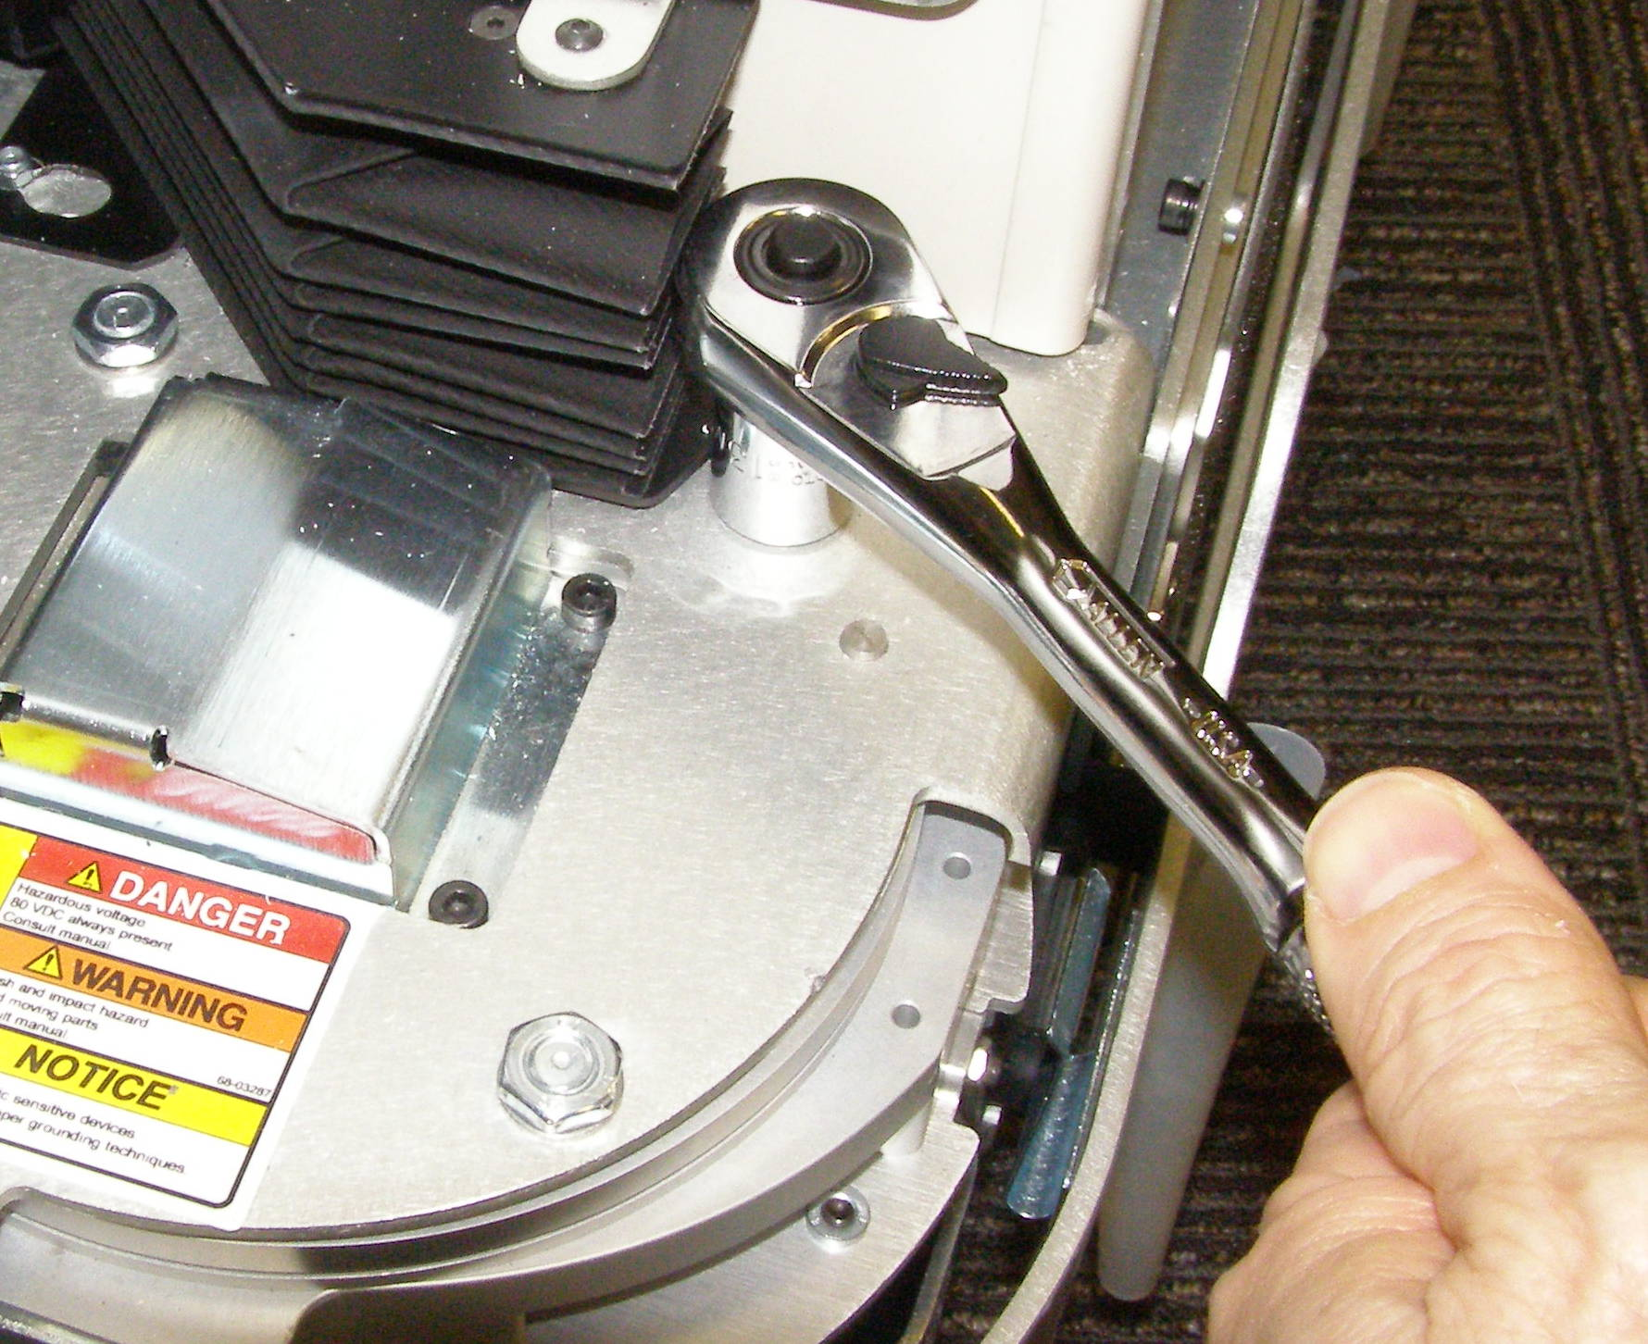
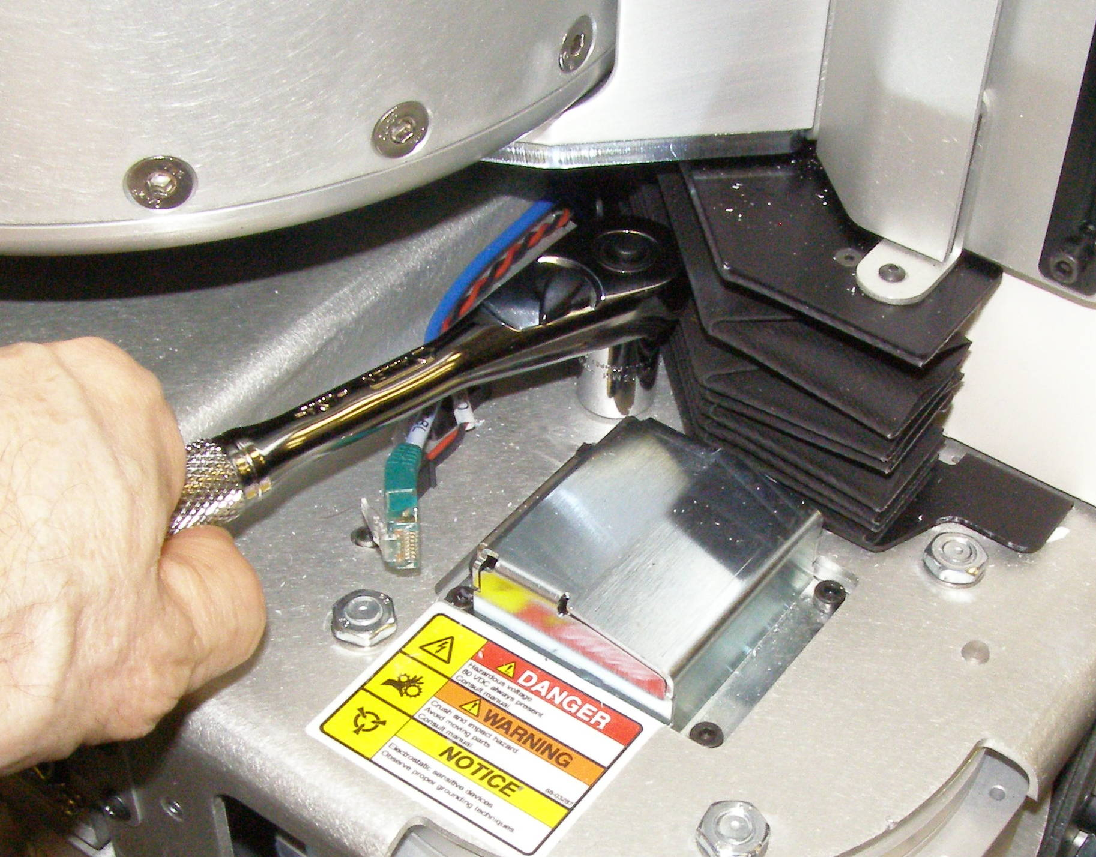
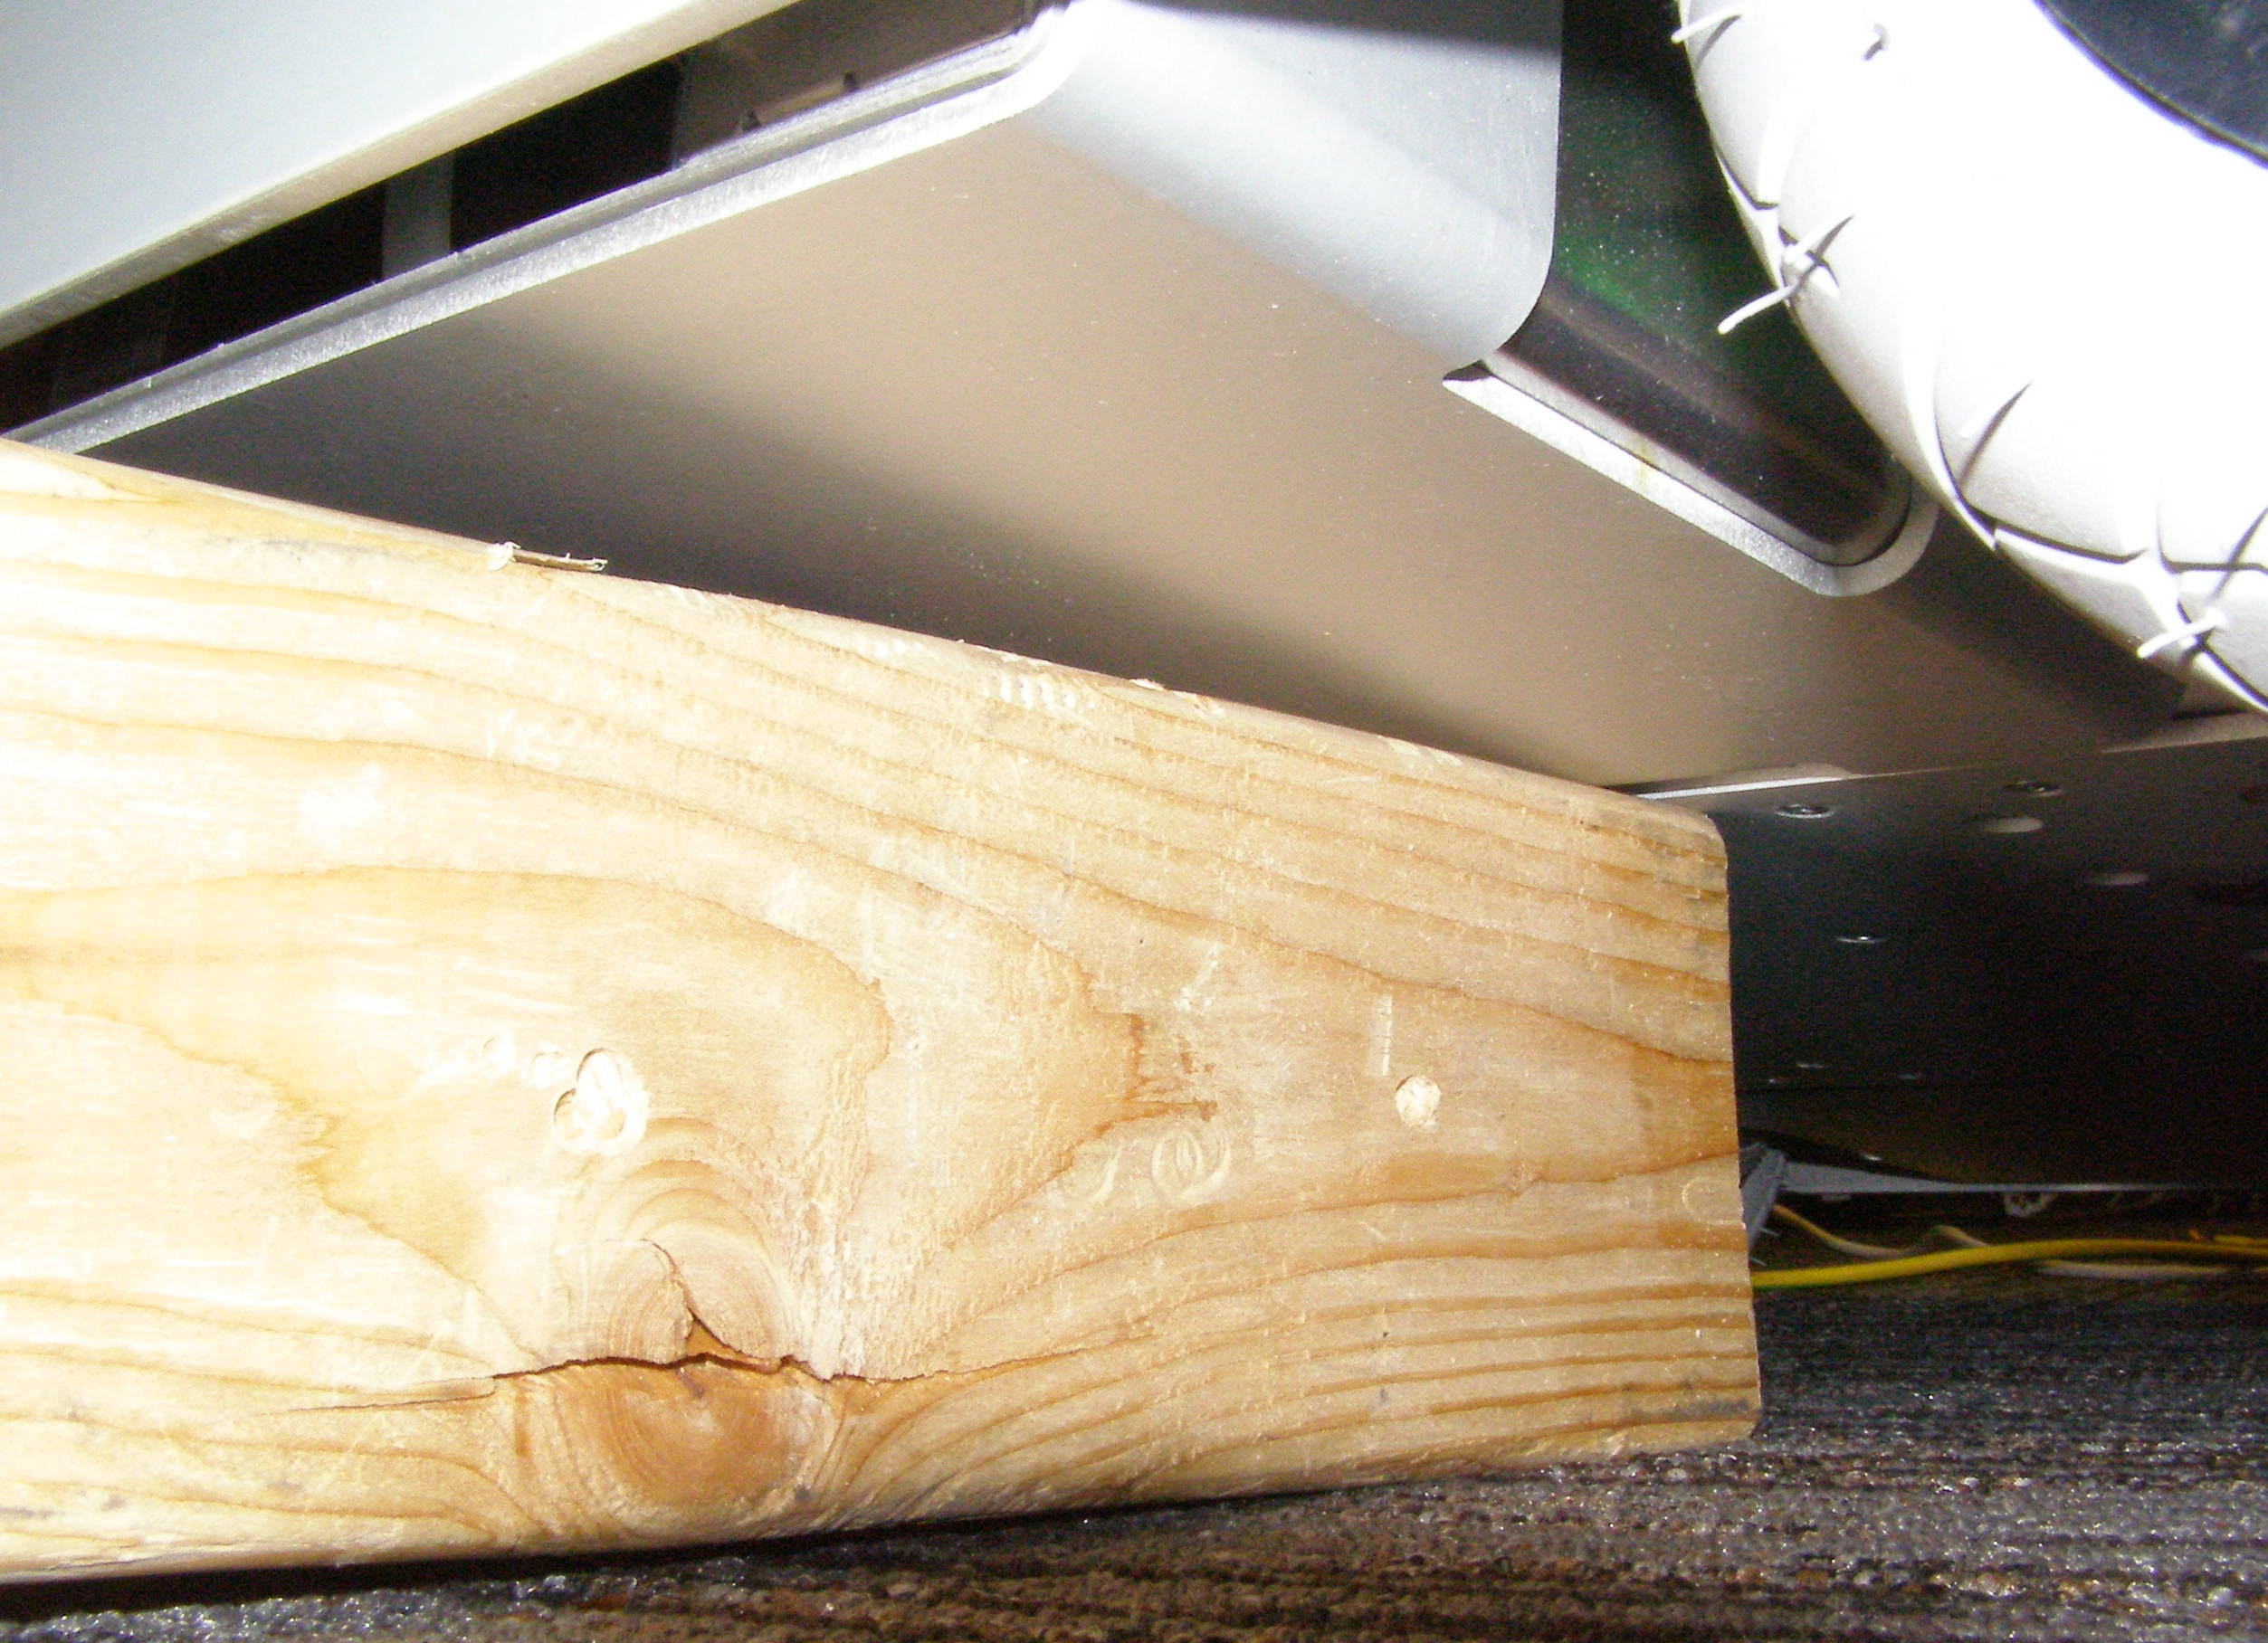
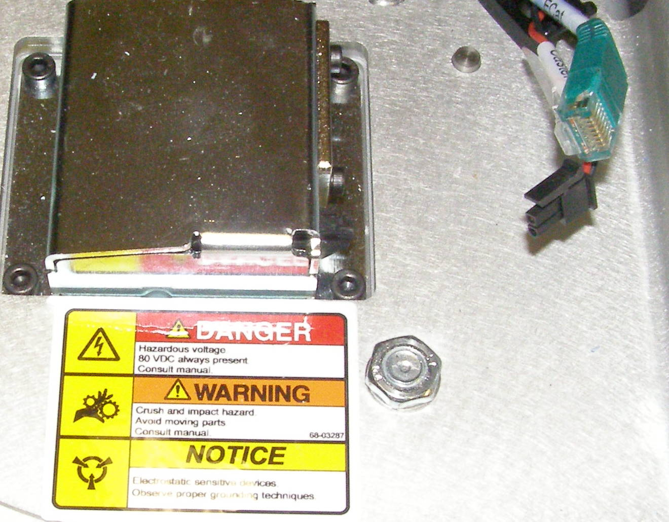
Caster R/R (1)
Caster, Removal – 4108 (requires 2 people)
  Raise Spine at least 6cm to remove rear Castors. If the Spine is not raised the rear Castors will be difficult to remove as the Bellows will interfere with the wrench. (Fig 1,2)
  Remove Top Front Panel and Rear Top Panel.
  Remove Front Bottom Panel.
  Remove Rear Bottom Panel to remove rear Castors.
  Remove Front Skirt.
  Remove Rear Skirt to remove rear Casters.
  With all 4 Castors pointed forward raise/tilt the Robot on the side the Caster is to be removed and support it. The Robot can be tilted by pushing on the Accesory plate. (Fig 3)
Fig 1
Fig 3
  A 2 x 4 positioned in the middle as shown is adequate. Make sure the front edge of the wood is supporting the Aluminum as shown. (Fig 3)
  Disconnect the 2 Cables from the Caster. (Fig 4)
Fig 2
Fig 4

Slide 3
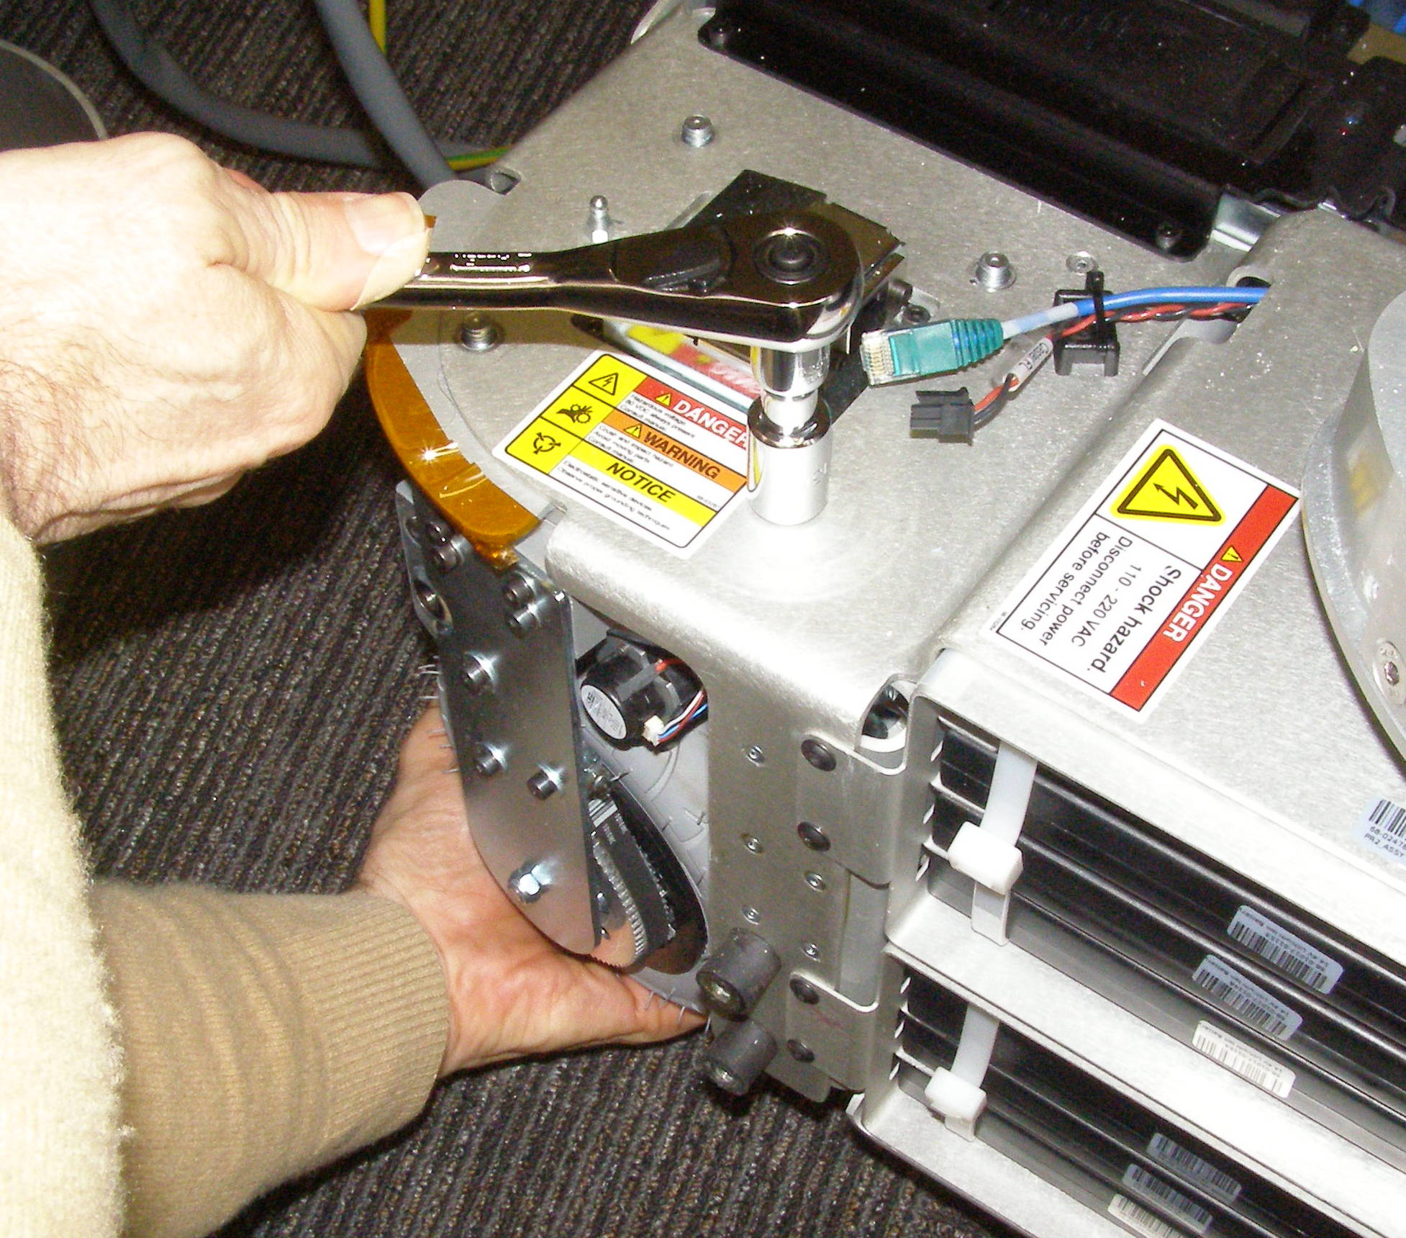
Caster R/R (2)
  Using the 3/8 drive ratchet wrench with the 13mm socket remove the 4 nuts, being careful to support the castor when removing the last nut so it does not fall down. 2351 (Fig 5)
Caster, Install
  Reverse the removal procedure.
  Holding the Caster from the bottom carefully offer it up to the Robot with the connectors facing inwards. The Caster cannot be installed backwards.
  Apply Loctite 248 to studs, initially install the nuts using the 3/8 drive ratchet wrench to make it easier, then finish torquing the nuts to 17Nm using the Titan wrench.
Fig 5

